Slide 1


GROUPED DATA
MATH30-6
Probability and Statistics

Slide 2
OBJECTIVES
The students at the end of the lesson are expected to:
Define and Differentiate various measures of describing data
Describe a given set of data using various measures
Interpret values that arises from computation

Slide 3
Grouped Data
Data Computation made when the data are clustered or classified along various intervals.
Usually used when data exceeds 30 entries
Uses the frequency distribution table

Slide 4
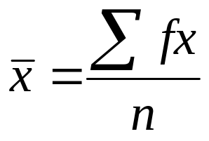
Measure of Central Tendency
Mean
  A parameter used to locate the average value or that would have the same effect as all of the data
f is the frequency of each class
x is the class marks
n is the total number of observations

Slide 5
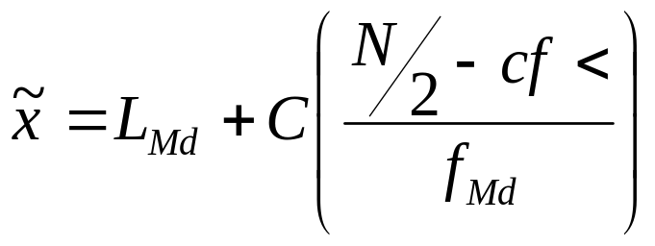
Measure of Central Tendency
Median
Median is the value that divides the distribution to equal number of elements
L_{Md} is the lower class boundary of the median class
C is the class width
N is the total number of observations
f_{Md} is the frequency of the median class
cf< is the cumulative frequency of the preceding class

Slide 6
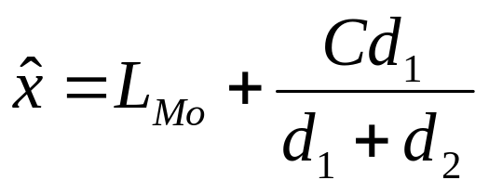
Measure of Central Tendency
Mode
Mode is the value that occurs most often in a distribution
L_{Mo} is the lowest class boundary of the modal class
d₁ = f_{med} – f_{mod – 1} or the difference between the frequencies of
the modal class preceding it.
d₂ = f_{med} – f_{mod + 1} or the difference between the frequencies of
the modal class following it.

Slide 7
Measure of Position
The use of Fractiles/ Quantiles as a measure of location describe or locate the position of a certain piece of data relative to the entire set of data. Unlike the median which just divides the distribution into 2 equal parts, which are the upper and lower 50%, quantiles divide a given distribution into n equal parts. The common fractiles are the quartile, decile and percentile

Slide 8
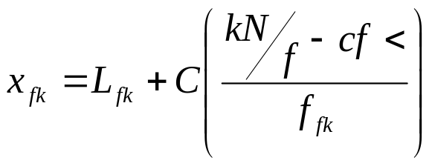
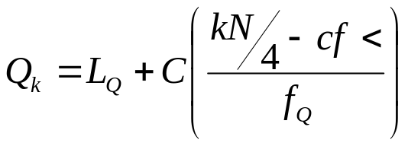
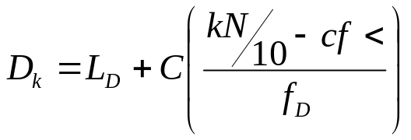
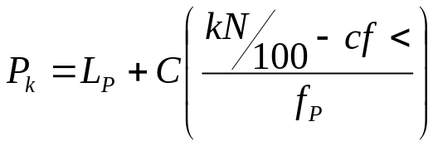
Measure of Position
General Formula
Quartile
Decile
Percentile
L_{Q}, L_{D}, L_{P} is the lower class boundary of the Q/D/P class
cf< is the cumulative freq of the class preceding class
f_{Q}, f_{D}, f_{P} frequency of the Q/D/P class
C is the size class interval

Slide 9
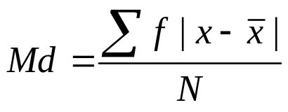
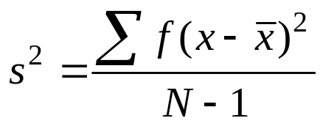
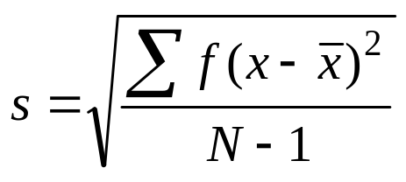
Measure of Variation
Mean Deviation
Variance
Standard Deviation

